Slide 1
Updated dilute CV-SANS results
Bailee Barrett
February 02, 2022
Zhang Research Group

Slide 2
General overview of singly charged peptoid library
Schematic of singly charged peptoid chains:
Sequence 1 (S1)
Sequence 3 (S3)
Sequence 5 (S5)
Overall density of peptoid: 0.99 g/mL
Where:
=
=
=
General structure of singly charged peptoid
Density: 1.00 g/mL
Density: 1.00 g/mL
Density: 0.95 g/mL

Slide 3
Sequence one
2022 data
(with thermal annealing)
2019 data

Slide 4
Sequence three
2022 data
(with thermal annealing)
2019 data

Slide 5
Sequence five
2022 data
(with thermal annealing)
2019 data

Slide 6
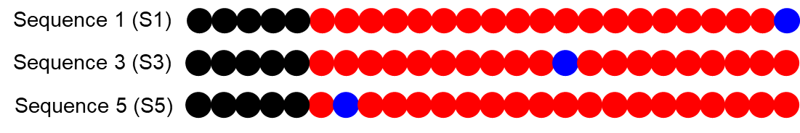
Comparison of all sequences

Slide 7
Comparison of each contrast
100% D₂O
95% D₂O
90% D₂O

Slide 8
Comparison of each contrast
85% D₂O
80% D₂O
75% D₂O

Slide 9
Chemical structure without counter ion:
Chemical structure without counter ion:
Molecular Weight: 3361.29 g/mol
Hydrophobic segment:
Hydrophilic segment:
Molecular Formula: C₁₆₂H₂₉₇N₂₆O₄₇
Molecular Weight: 1029.66 g/mol
Molecular Weight: 2331.64 g/mol
Molecular Formula: C₆₂H₁₁₈N₅O₆
Molecular Formula: C₁₀₀H₁₇₉N₂₁O₄₁
Number of labile protons in single surfactant: Zero
Number of labile protons in single surfactant: Zero
Number of labile protons in single surfactant: Zero

Slide 10
CV SANS-dilute solutions
IPTS#25413
Experiments completed: January 2022
Polymer conc. (mg/mL)
Sequence | 100% D₂O | 95% D₂O | 90% D₂O | 85% D₂O | 80% D₂O | 75% D₂O
1 | 3.00 | 3.09 | 3.01 | 3.03 | 3.01 | 3.03
3 | 3.01 | 3.10 | 3.06 | 3.04 | 3.07 | 3.01
5 | 3.01 | 3.04 | 3.08 | 3.05 | 3.09 | 3.03
Solvent (v/v)
Solvent | H (vol%) | D (vol%) | H (wt%) | D (wt%)
001 | 0 | 100 | 0.00 | 100
002 | 5 | 95 | 4.8659 | 95.134
003 | 10 | 90 | 9.3118 | 90.688
004 | 15 | 85 | 13.977 | 86.023
005 | 20 | 80 | 18.331 | 81.669
006 | 25 | 75 | 23.376 | 76.624
Polymer conc. (mg/g)
Sequence | 100% D₂O | 95% D₂O | 90% D₂O | 85% D₂O | 80% D₂O | 75% D₂O
1 | 2.679 | 2.738 | 2.696 | 2.736 | 2.693 | 2.764
3 | 2.681 | 2.732 | 2.715 | 2.724 | 2.750 | 2.718
5 | 2.696 | 2.692 | 2.742 | 2.756 | 2.777 | 2.740

Slide 11
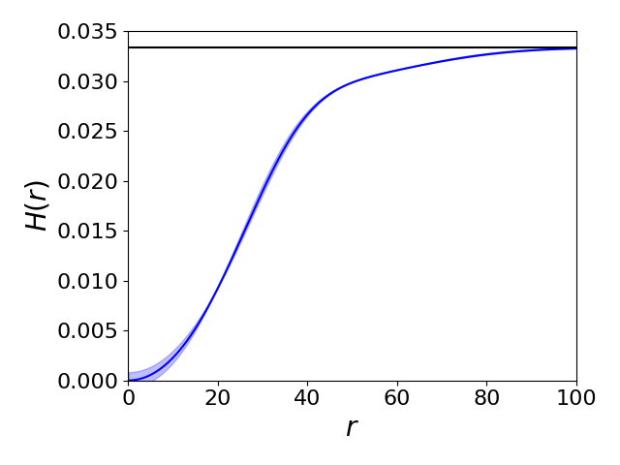
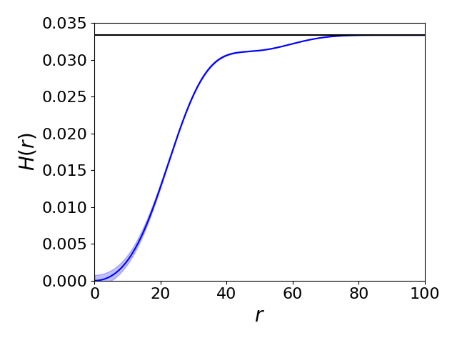
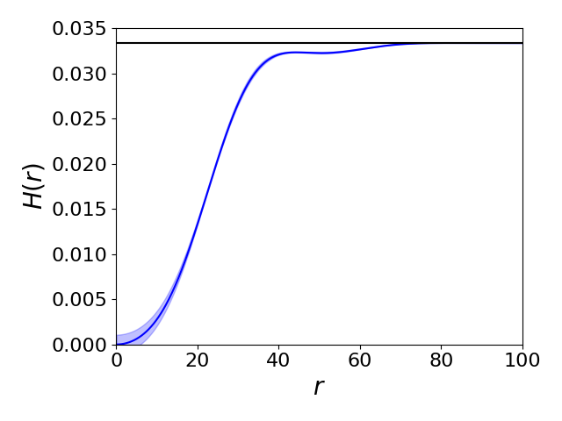
Radial distributions of water
S1
S3
S5

Slide 12
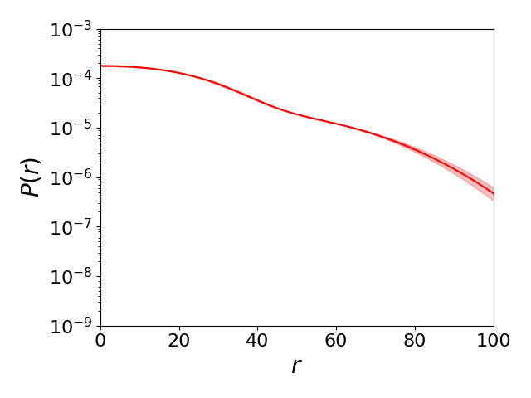
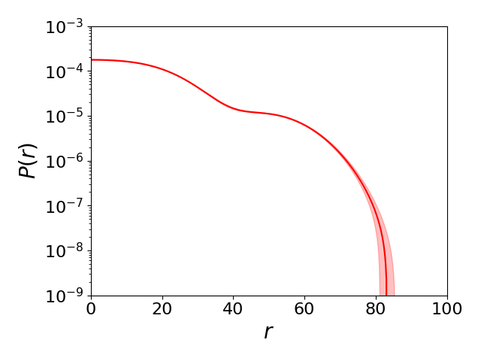
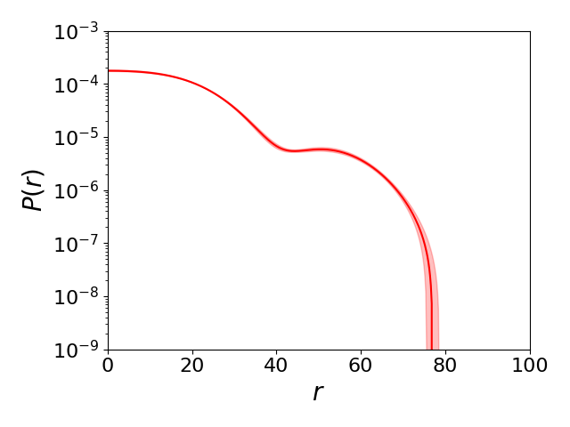
Radial distributions of polymer
S1
S3
S5

Slide 13
Conformational Parameters
S1
n_m = 2.6072e-08 ± 1.4379e-11, N_agg = 4.4247e+01 ± 1.8495e+00,
Rg = 5.1005e+01 ± 6.8569e-01, Rb = 9.3800e+01 ± 1.2610e+00,
n_u = -6.1808e-07 ± 2.4111e-08, f_m = 2.1542e+00 ± 4.5025e-02,
phi_m = 9.0130e-02 ± 1.0496e-03
S3
n_m = 4.8792e-08 ± 2.3296e-11, N_agg = 2.1577e+01 ± 5.5985e-01,
Rg = 3.9347e+01 ± 3.2258e-01, Rb = 6.5200e+01 ± 5.3453e-01,
n_u = -5.1729e-07 ± 1.3660e-08, f_m = 1.9660e+00 ± 2.5509e-02,
phi_m = 5.6648e-02 ± 4.0242e-04
S5
n_m = 4.5783e-08 ± 4.3690e-11, N_agg = 1.5617e+01 ± 7.9585e-01,
Rg = 3.4827e+01 ± 5.4734e-01, Rb = 6.0600e+01 ± 9.5239e-01,
n_u = -1.7950e-07 ± 1.8221e-08, f_m = 1.3352e+00 ± 3.4026e-02,
phi_m = 4.2679e-02 ± 5.8123e-04

